Slide 1
IT694 Computer Networks Week 9-Lec 1
IP addressing

Slide 2

IP addressing: introduction
223.1.1.1
IP address: 32-bit identifier associated with each host or router interface
interface: connection between host/router and physical link
router’s typically have multiple interfaces
host typically has one or two interfaces (e.g., wired Ethernet, wireless 802.11)
223.1.2.1
223.1.1.2
223.1.1.4
223.1.2.9
223.1.1.3
223.1.3.27
223.1.2.2
223.1.3.1
223.1.3.2
dotted-decimal IP address notation:
223.1.1.1 = 11011111 00000001 00000001 00000001
223
1
1
1

Slide 3
IP addressing: introduction
223.1.1.1
IP address: 32-bit identifier associated with each host or router interface
interface: connection between host/router and physical link
router’s typically have multiple interfaces
host typically has one or two interfaces (e.g., wired Ethernet, wireless 802.11)
223.1.2.1
223.1.1.2
223.1.1.4
223.1.2.9
223.1.1.3
223.1.3.27
223.1.2.2
223.1.3.1
223.1.3.2
dotted-decimal IP address notation:
223.1.1.1 = 11011111 00000001 00000001 00000001
223
1
1
1

Slide 4

IP addressing: introduction
223.1.1.1
Q: how are interfaces actually connected?
223.1.2.1
223.1.1.2
A: we’ll learn about that in chapters 6, 7
A: wired
Ethernet interfaces connected by Ethernet switches
223.1.1.4
223.1.2.9
223.1.1.3
223.1.3.27
223.1.2.2
223.1.3.1
223.1.3.2
For now: don’t need to worry about how one interface is connected to another (with no intervening router)
A: wireless WiFi interfaces connected by WiFi base station

Slide 5
Subnets
223.1.1.1
What’s a subnet ?
device interfaces that can physically reach each other without passing through an intervening router
223.1.2.1
223.1.1.2
223.1.1.4
223.1.2.9
223.1.1.3
223.1.3.27
223.1.2.2
IP addresses have structure:
subnet part: devices in same subnet have common high order bits
host part: remaining low order bits
223.1.3.1
223.1.3.2
network consisting of 3 subnets

Slide 6
Subnets
subnet 223.1.1.0/24
223.1.1.1
subnet 223.1.2.0/24
Recipe for defining subnets:
detach each interface from its host or router, creating “islands” of isolated networks
each isolated network is called a subnet
223.1.2.1
223.1.1.2
223.1.1.4
223.1.2.9
223.1.1.3
223.1.3.27
223.1.2.2
subnet
223.1.3.0/24
223.1.3.1
223.1.3.2
subnet mask: /24
(high-order 24 bits: subnet part of IP address)

Slide 7
Subnets
223.1.1.2
subnet 223.1.1/24
where are the subnets?
what are the /24 subnet addresses?
223.1.1.1
223.1.1.4
223.1.1.3
223.1.9.2
223.1.7.0
subnet 223.1.7/24
subnet 223.1.9/24
223.1.9.1
223.1.7.1
223.1.8.1
223.1.8.0
subnet 223.1.2/24
223.1.2.6
subnet 223.1.8/24
223.1.3.27
subnet 223.1.3/24
223.1.2.1
223.1.2.2
223.1.3.1
223.1.3.2

Slide 8
IP addresses: how to get one?
That’s actually two questions:
Q: How does a host get IP address within its network (host part of address)?
Q: How does a network get IP address for itself (network part of address)
How does host get IP address?
hard-coded by sysadmin in config file (e.g., /etc/rc.config in UNIX)
DHCP: Dynamic Host Configuration Protocol: dynamically get address from as server
“plug-and-play”

Slide 9
DHCP: Dynamic Host Configuration Protocol
goal: host dynamically obtains IP address from network server when it “joins” network
can renew its lease on address in use
allows reuse of addresses (only hold address while connected/on)
support for mobile users who join/leave network
DHCP overview:
host broadcasts DHCP discover msg [optional]
DHCP server responds with DHCP offer msg [optional]
host requests IP address: DHCP request msg
DHCP server sends address: DHCP ack msg

Slide 10
IP addresses: how to get one?
Q: how does network get subnet part of IP address?
A: gets allocated portion of its provider ISP’s address space
ISP's block 11001000 00010111 00010000 00000000 200.23.16.0/20
ISP can then allocate out its address space in 8 blocks:
Organization 0 11001000 00010111 00010000 00000000 200.23.16.0/23
Organization 1 11001000 00010111 00010010 00000000 200.23.18.0/23
Organization 2 11001000 00010111 00010100 00000000 200.23.20.0/23
... ….. …. ….
Organization 7 11001000 00010111 00011110 00000000 200.23.30.0/23

Slide 11
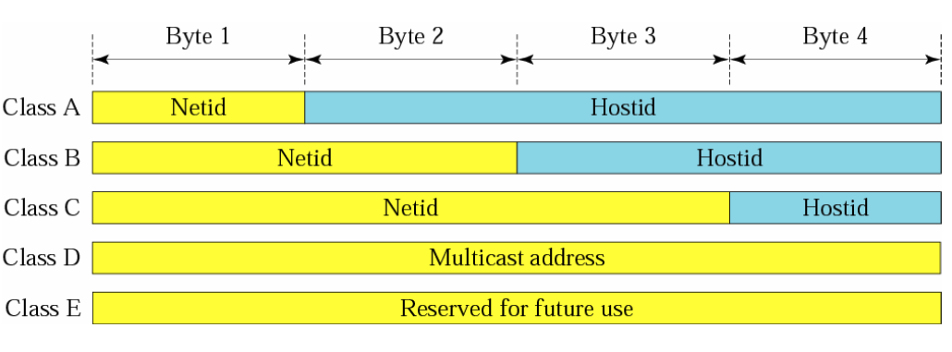
Network and Host IDs

Slide 12
Methods of allocating addresses?
Classful
Fixed Length Subnet Mask (FLSM)
Variable Length Subnet Mask(VLSM)

Slide 13
Subnetting Types
There are three types of subnetting examples :
1) Subnetting when given a required number of networks
2) Subnetting when given a required number of clients
3) Given an IP address & Subnet Mask, finding original network range

